Slide 1
Chapter 2 lesson 3: Metamorphic Rocks
Describe the conditions in Earth that cause metamorphic rocks to form
Classify metamorphic rocks as foliated or nonfoliated

Slide 2
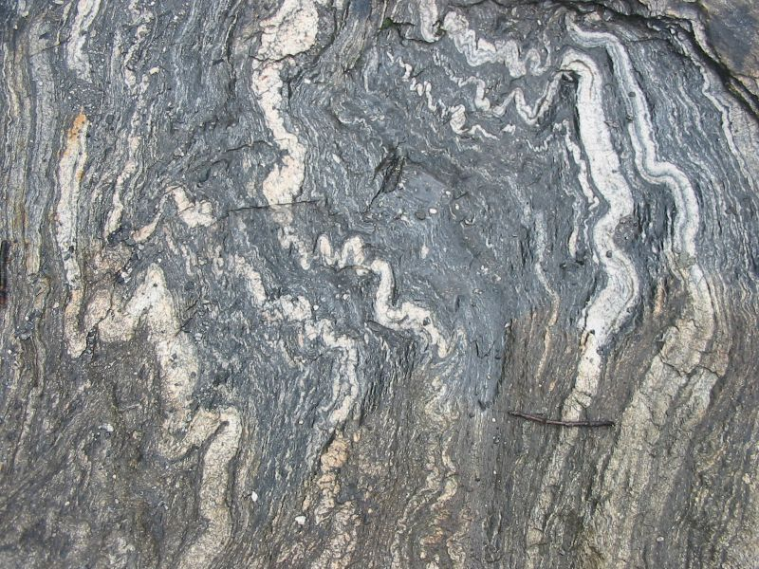
Formation of Metamorphic Rocks
Rocks that are changed by temperature and pressure

Slide 3
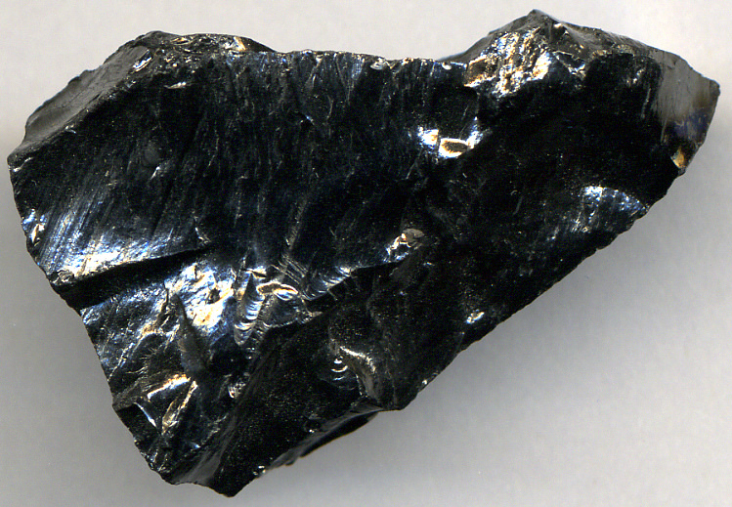
Metamorphic Rocks
Rocks that have changed because of changes in temperature and pressure or the presence of hot, watery fluids.
Can be formed from igneous, sedimentary or other metamorphic rocks

Slide 4
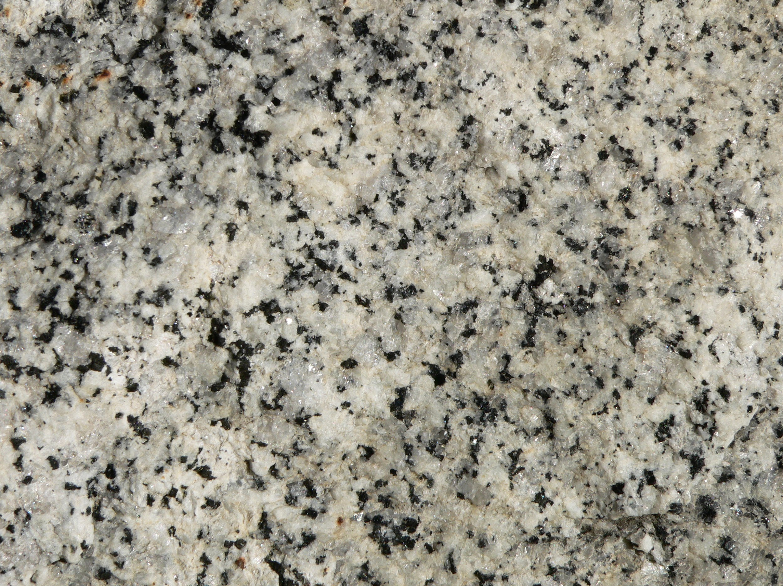
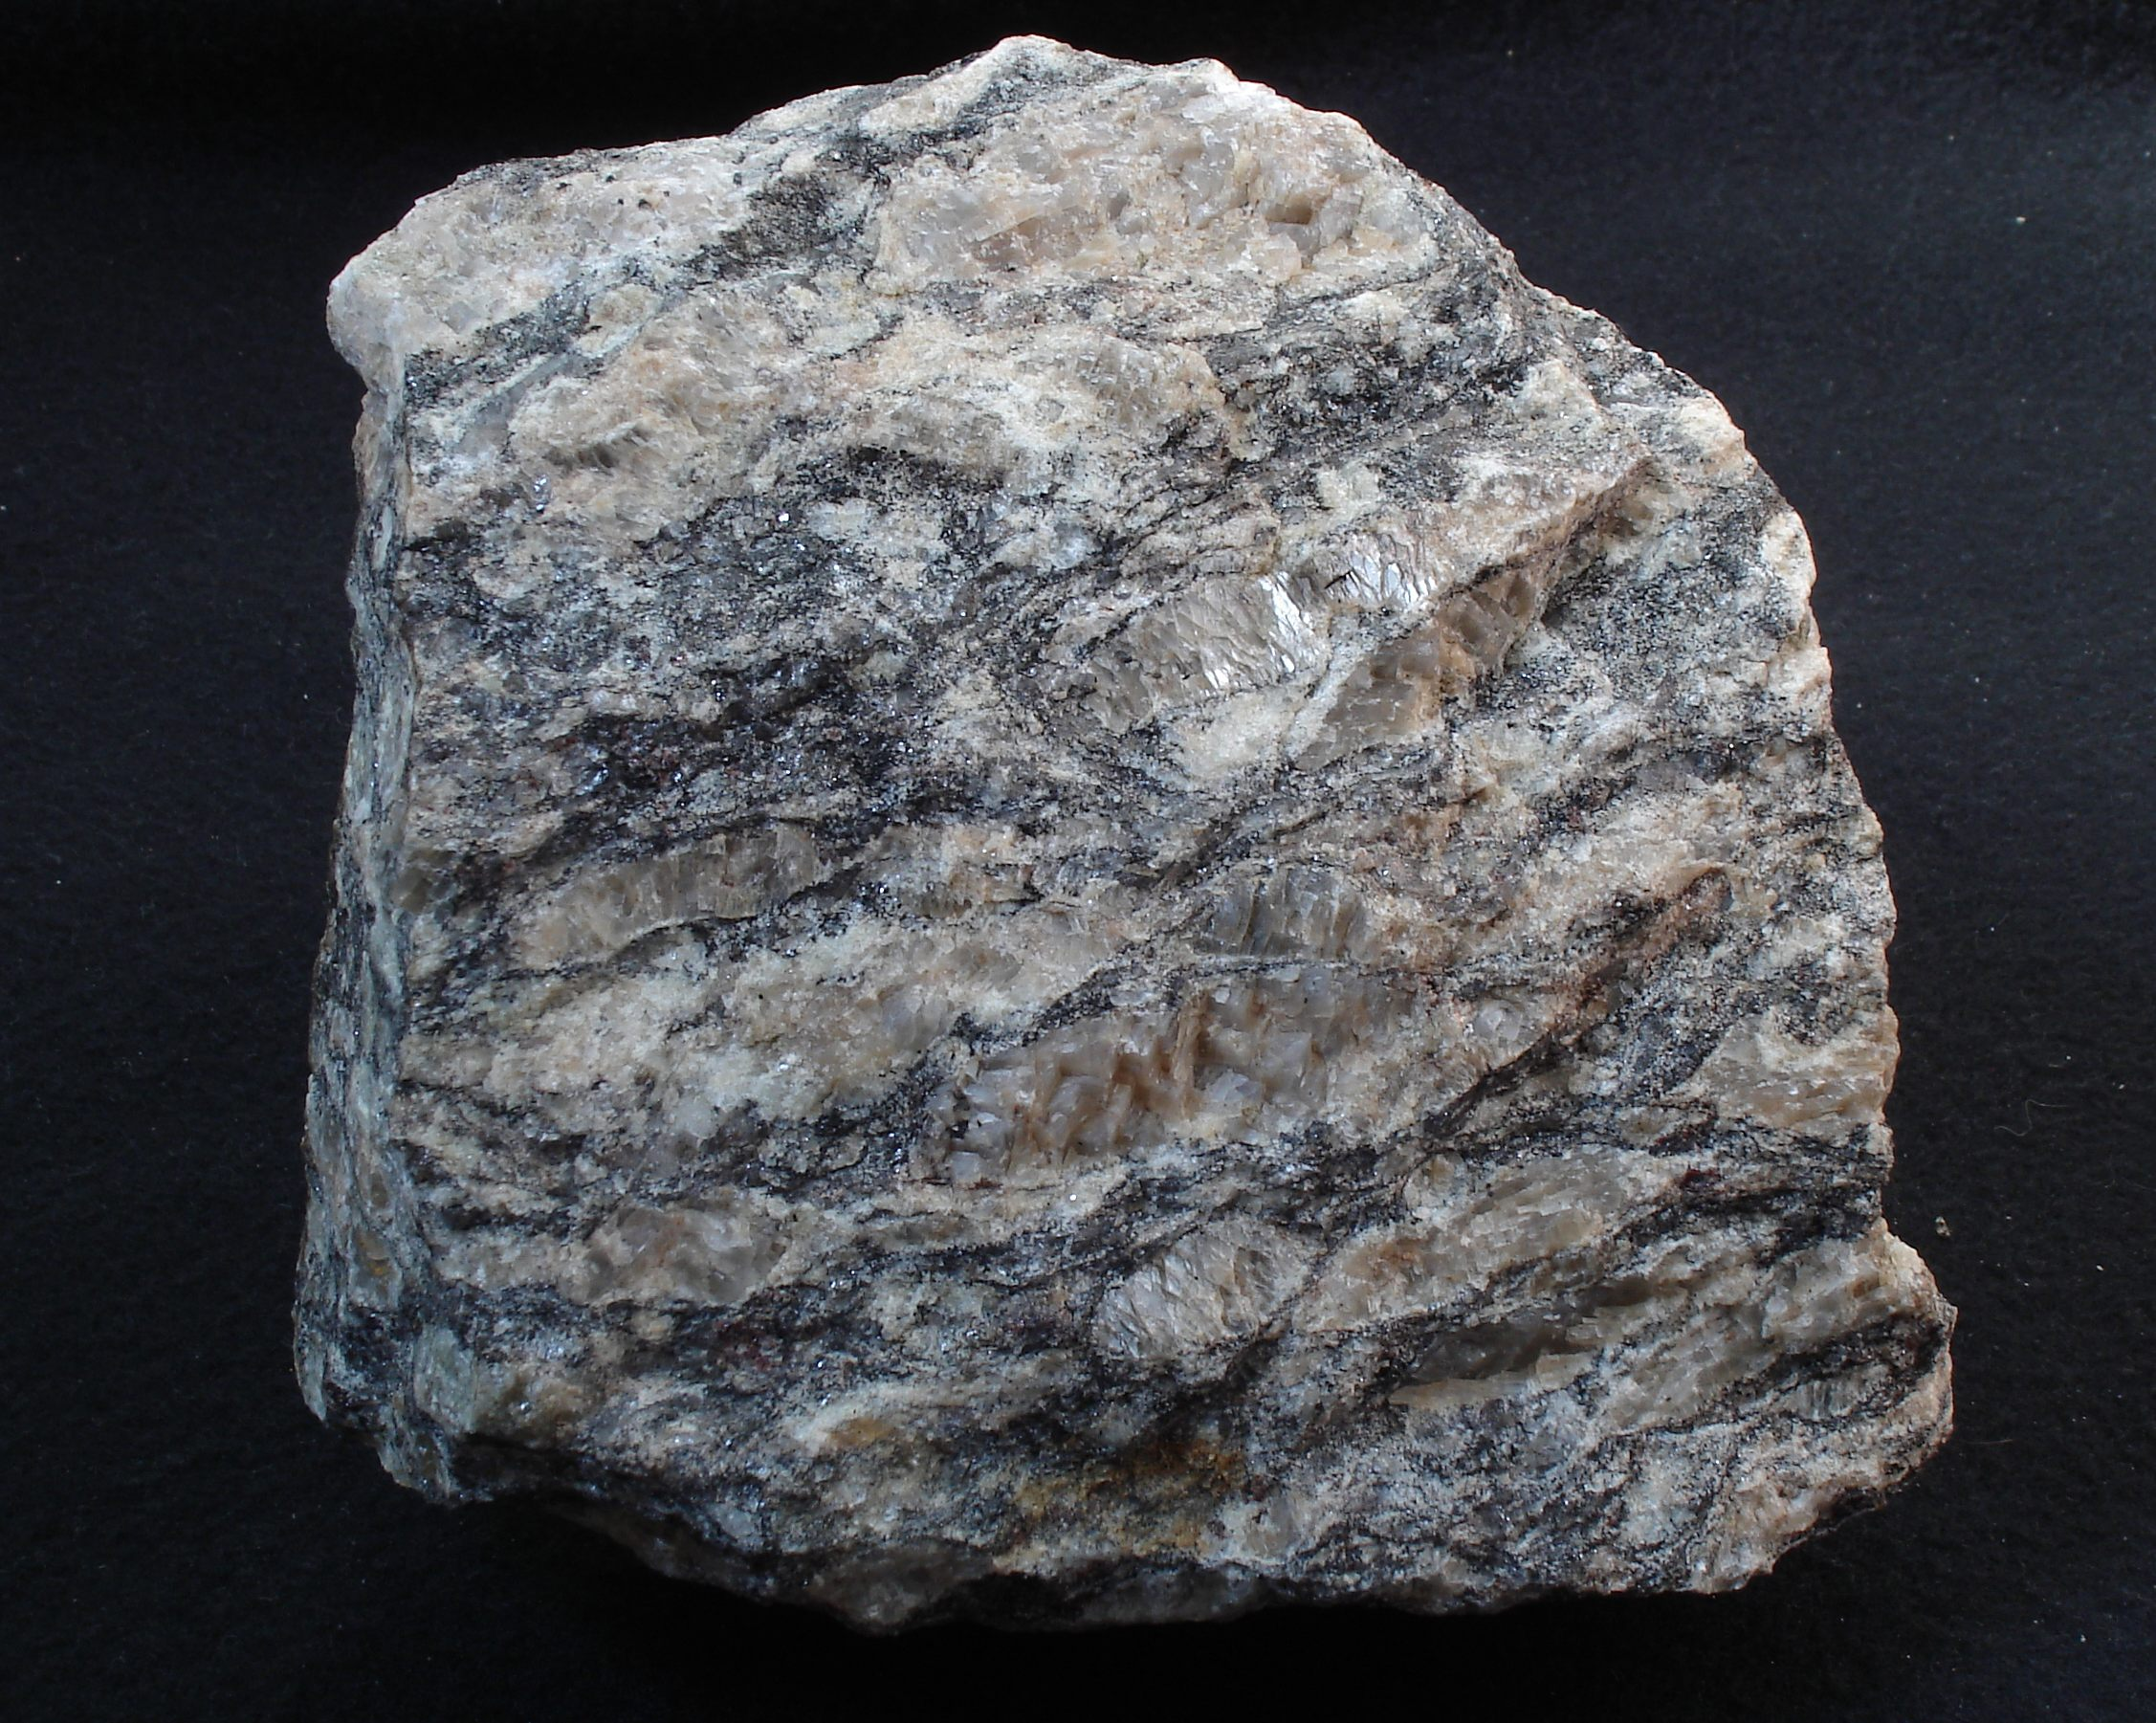
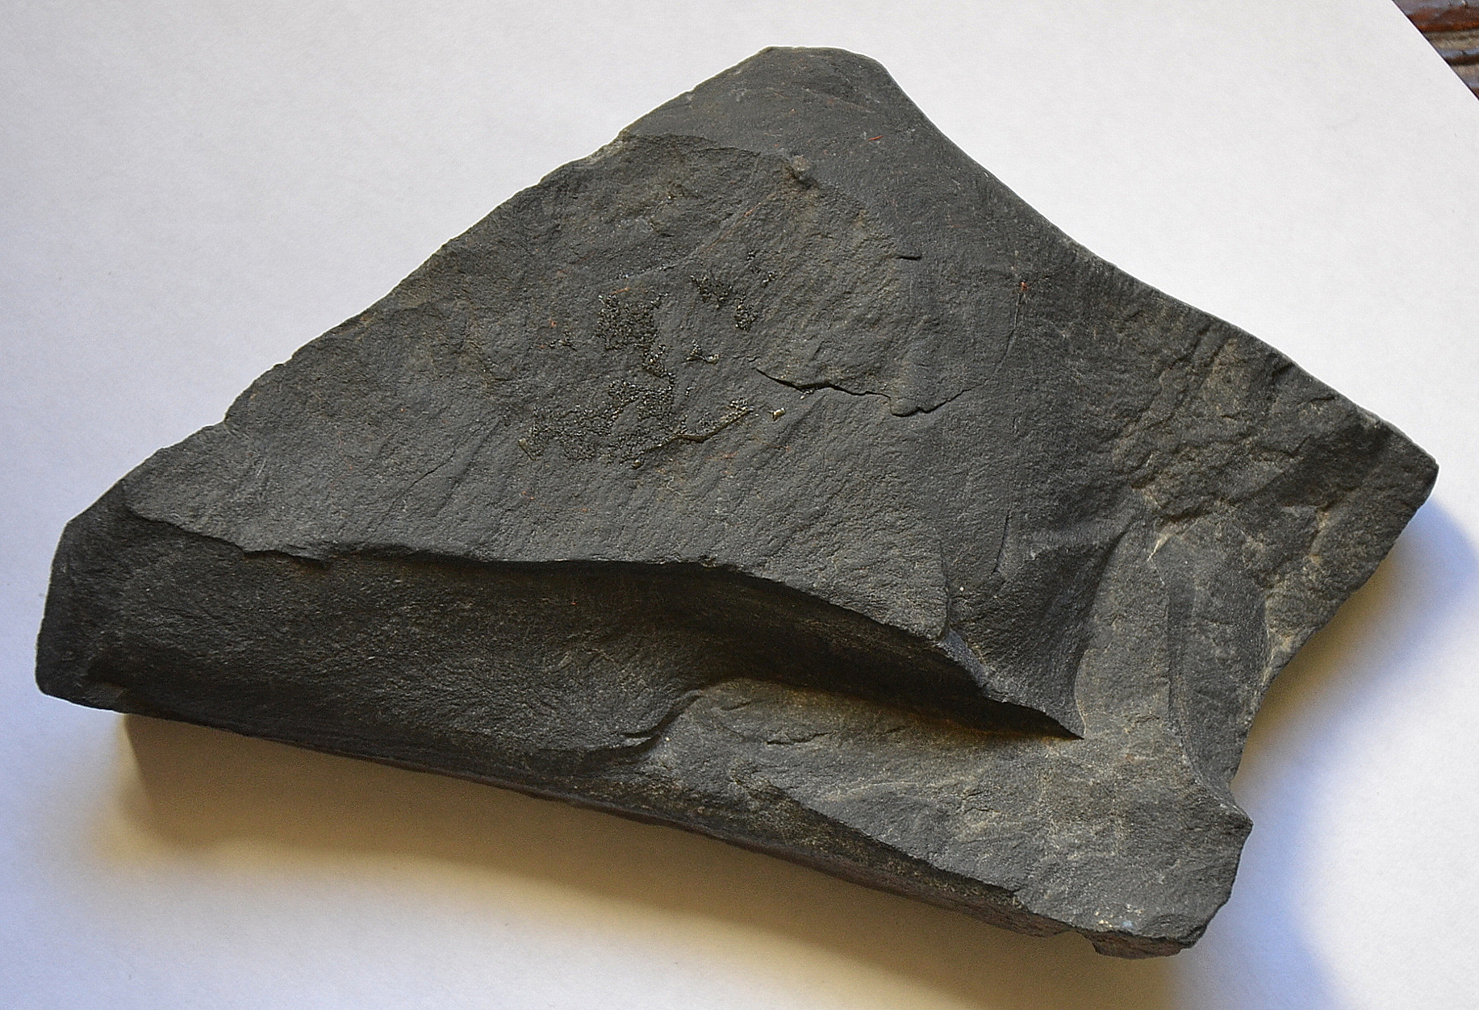
2. Heat and Pressure
Shale changes to slate
Slate changes to phyllite, and schist then to gneiss
Granite changes to Gneiss

Slide 5
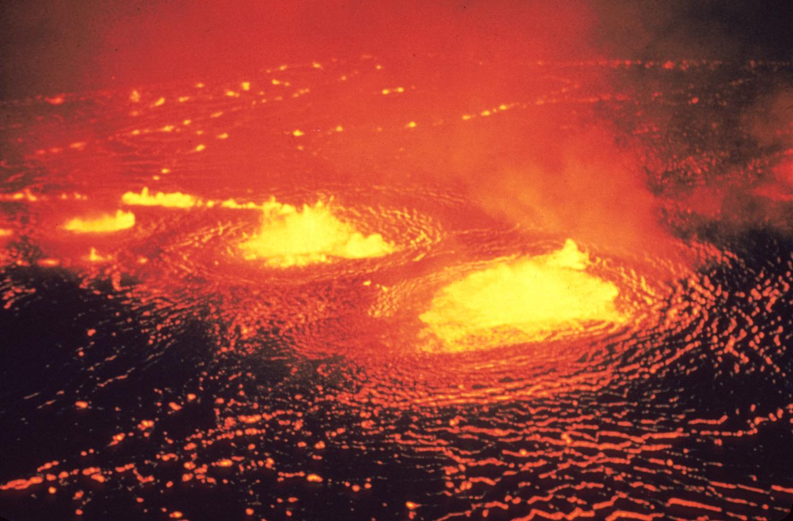
3. Hot Fluids
In the process of hot, water-rich fluids, solid rock can change in mineral composition without having to melt.

Slide 6
B. Classifying Metamorphic Rocks
Metamorphic rocks can be classified according to its composition and texture.

Slide 7
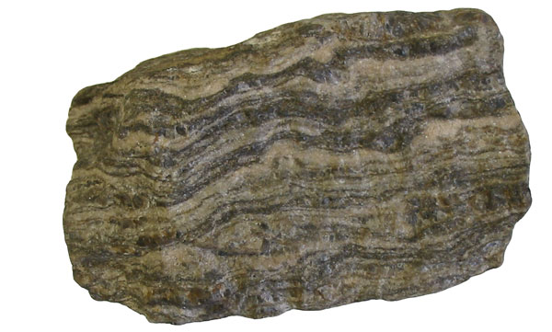
Foliated Rocks
When mineral grains line up in parallel layers
Examples:
Slate - forms from shale
Gneiss - forms when granite and other rocks are changed

Slide 8
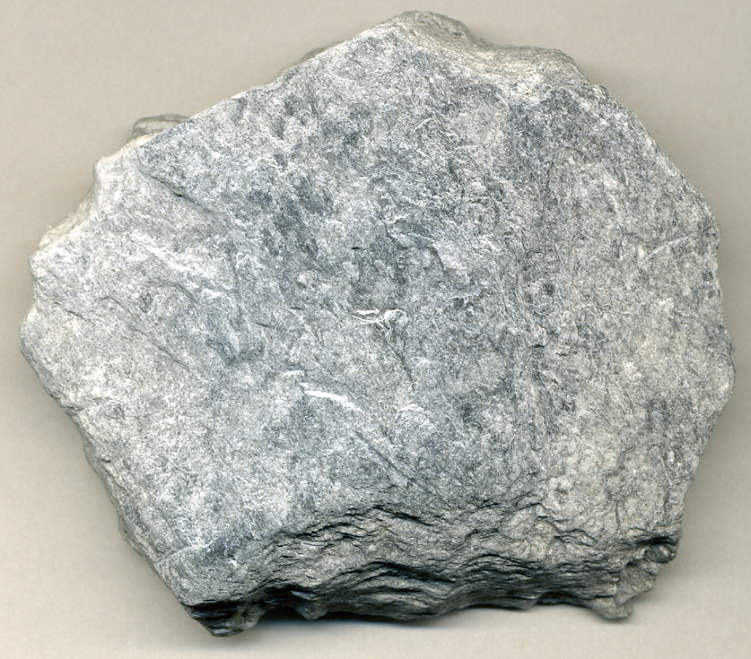
2. Nonfoliated Rocks
When mineral grains grow and rearrange, but they do not form layers
Example
Quartzite
Marble- form from limestone

